Slide 1
Predicting Housing Prices
Griffin Hundley, Malcolm Katzenbach, Lauren Phipps

Slide 2

Overview
Business Problem
Data
Visualizations and Modeling
Validation of Model
Conclusions & Next Steps

Slide 3
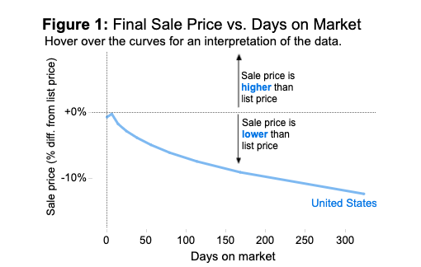
Business Problem
Houses priced too high will stay on the market for too long lose their value
Houses priced too low minimize the return for sellers and size of commission for realtors
Pricing accurately will ensure that houses sell faster and maximize the return for sellers and realtors
Source: Zillow

Slide 4







Data
21,000 homes sold between 2014-2015 in King County, WA
Example House Features:
image: Flaticon.com
Notes:
21, 597 houses

Slide 5
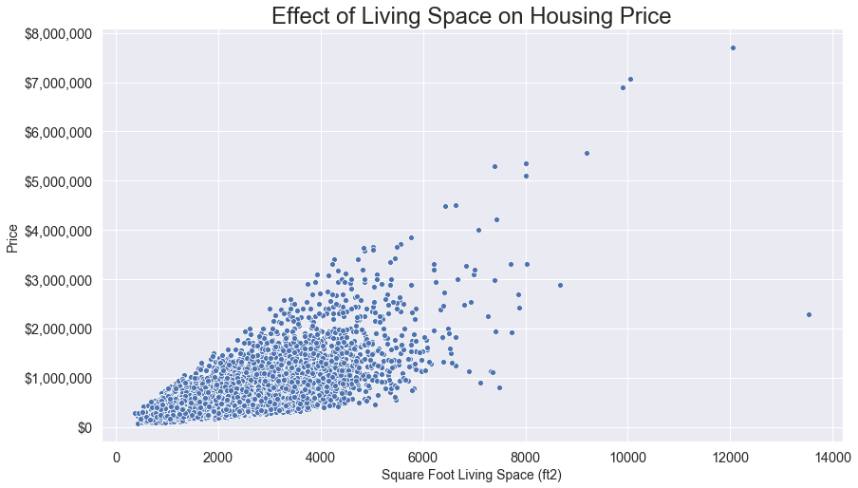

Slide 6
Results
42% of changes in house price are accounted for by changes in these features
Features Used:
Waterfront : Adds $860,000
Housing Grade : Adds $200,000
Number of Bathrooms : Adds $130,000
Years Old : Adds $4,615

Slide 7

Prediction with Model
2.5 Bathrooms
Housing Grade : 8
Waterfront? No
32 Years Old
Predicted Price: $576,070
Actual Price: $562,500

Slide 8

Conclusion &
Next Steps
Important predictors: bathrooms, housing grade, waterfront, and how old the house is
Got within $100,000 generally
Generalizable across new data
Next steps:
Model evaluation shows more factors should be included
Look into zip code and location data in comparison to city features
Investigate different interactions between features

Slide 9
Contact Info
Griffin Hundley:
Email: hundlegq@dukes.jmu.edu
GitHub: griffinhundley
Malcolm Katzenbach:
Email: mkatzenbach8@gmail.com
GitHub: Mal206
Lauren Phipps:
Email: lhphipps@gmail.com
GitHub: laurenphipps

